Slide 1
Developing ChatBot 2-2 Make Echo Bot
Refresh-Foods Inc.
Yestin Yehoon Lee
Notes:
Echo Bot is just name
Let ChatBot just simply repeat what you have said.
The purpose is to understand how ChatBot is working on the Net.
Are you ready?

Slide 2



User is ready
Facebook
Local
Heroku
Sendgrid
User
Developer
Server
Email
Twilio
SMS

Slide 3
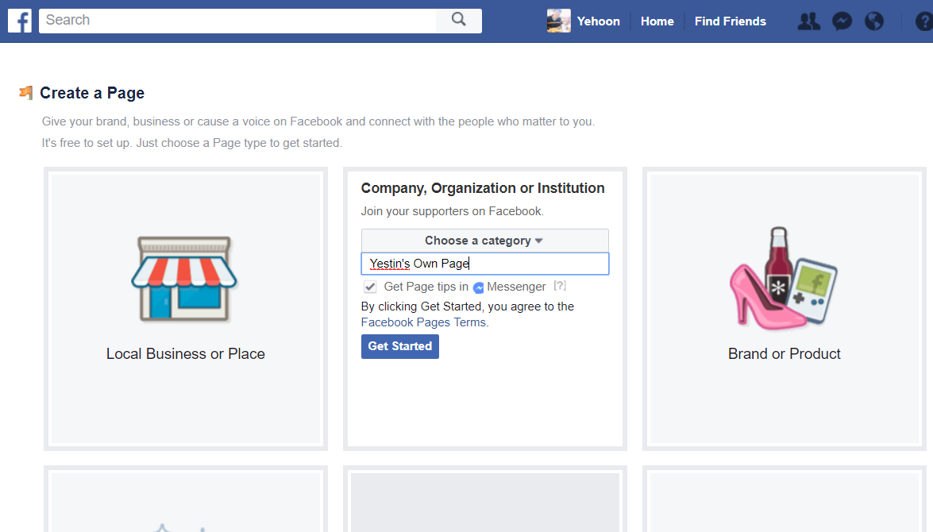
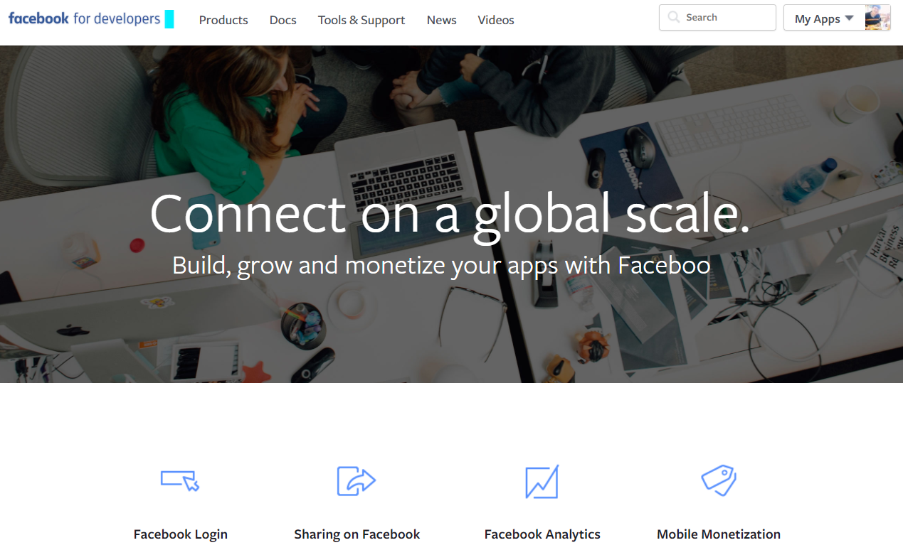
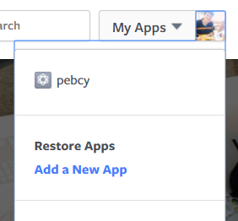
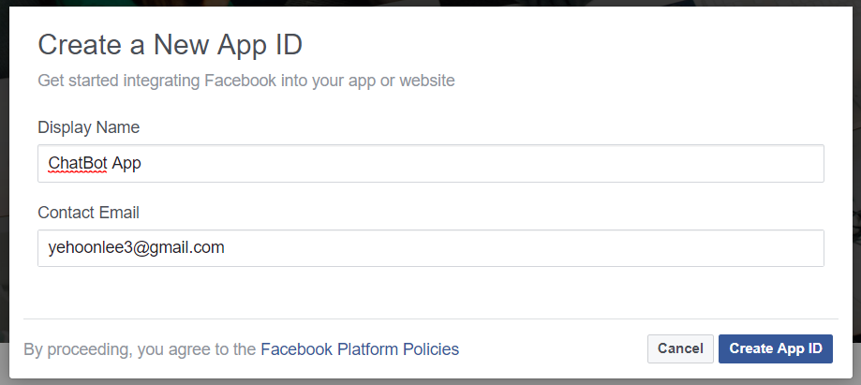
Create Facebook Page/App
Create Facebook page
Go to Facebook for developers
Create app
Notes:
Not personal page
Business page

Slide 4
Facebook is ready
Facebook
Local
Heroku
Sendgrid
User
Developer
Server
Email
Twilio
SMS

Slide 5
Edit app.js File
'use strict'
const express = require('express');
const bodyParser = require('body-parser');
const request = require('request');
const app = express();
app.set('port', (process.env.PORT || 5000));
app.use(bodyParser.urlencoded({ extended: false }));
app.use(bodyParser.json());
app.get('/', function(req, res) {
res.send('Hello world');
})
app.get('/webhook', function(req, res) {
if (req.query['hub.verify_token'] === 'VERIFY_TOKEN') {
res.send(req.query['hub.challenge']);
}
res.send('Error, wrong token');
})
app.listen(app.get('port'), function() {
console.log('running on port', app.get('port'));
})
Import modules
Create app object
Body-parser is to use json format
Visit home page send ‘Hello world’
When webhook occurs, check verify token
Display through which port server is listening
Make program run, just copy and paste
app.js
Notes:
Edit the main coding file app.js
It has many meanings.
But now we don’t focus on what codes are there.
Our purpose is just let program can run on the server.
This program actually don’t have serious meaning.
It just tells you server is running.

Slide 6
edit Package.json
...
"main": "app.js",
"scripts": {
"start": "node app.js"
},
...
package.json
Notes:
‘node’ is name of program
We execute code app.js

Slide 7
Code finished
Facebook
Local
Heroku
Sendgrid
User
Developer
Server
Email
Twilio
SMS

Slide 8
Push Code to Server
git init
git add .
git commit –m ‘first’
Heroku create app-name
git push Heroku master

Slide 9
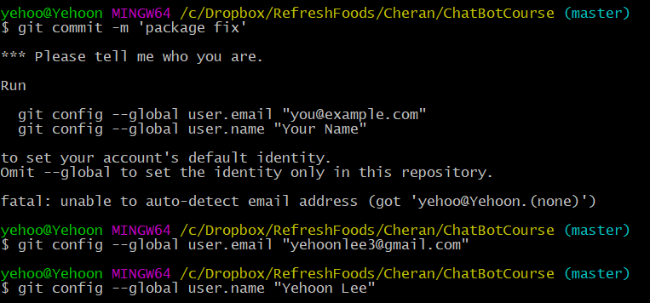
when commit Error occurs

Slide 10
Server is Ready
Facebook
Local
Heroku
Sendgrid
User
Developer
Server
Email
Twilio
SMS

Slide 11
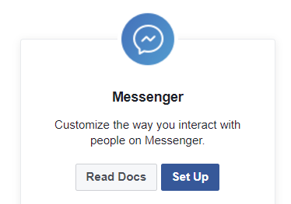
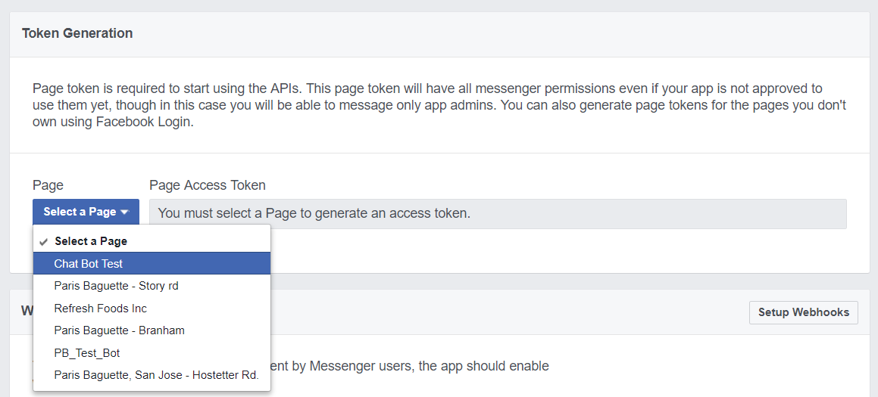
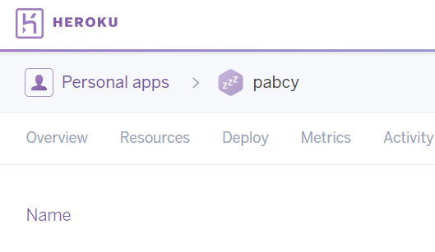
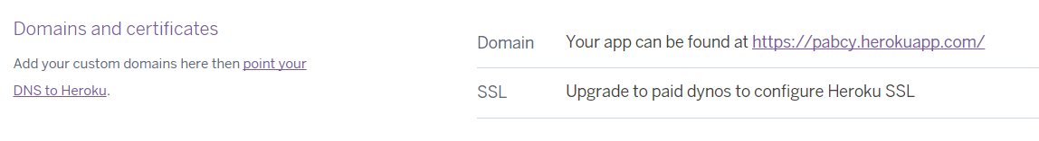
Link Facebook and Server
Go to messenger set up
Copy ‘Page Access Token’ to anywhere not open (key to the page what you just made)
Go to Heroku app dashboard
App setting
Copy app domain (It may be https://app-name.herokuapp.com/)

Slide 12
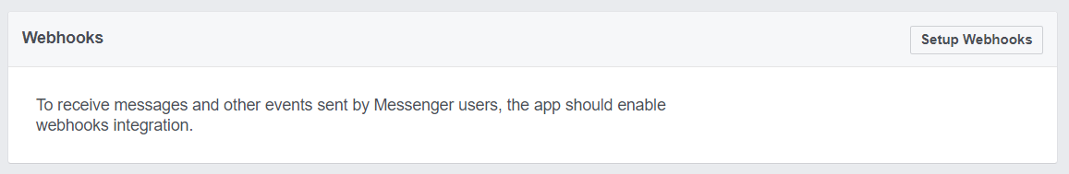
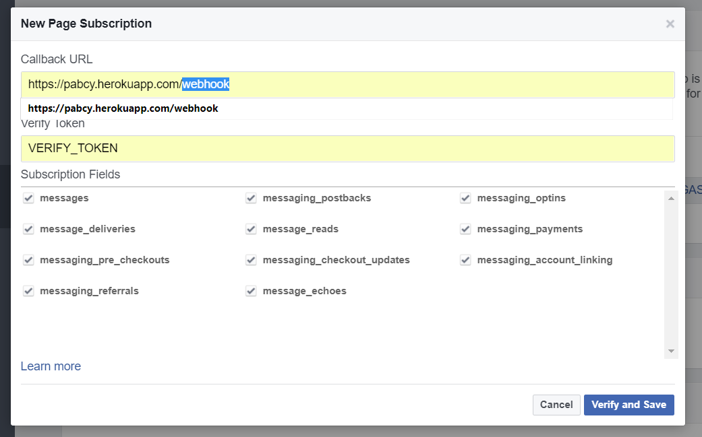
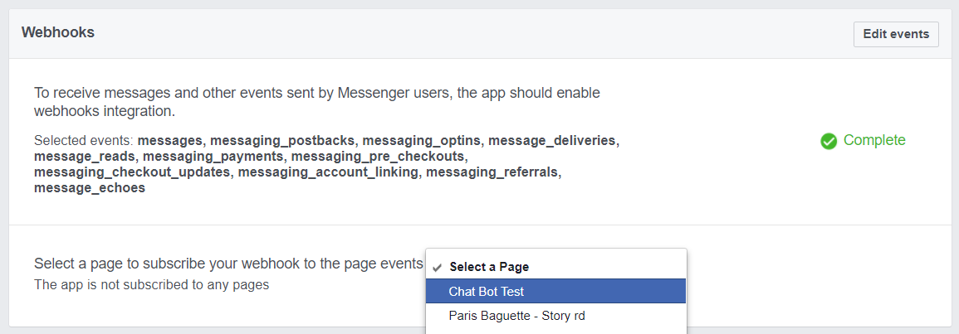
Webhook Setting
Click setup webhooks
Set callback URL as ‘Domain’ /webhook
Set VERIFY_TOKEN
Check all
Select page and subscribe

Slide 13
Everything is ready
Facebook
Local
Heroku
Sendgrid
User
Developer
Server
Email
Twilio
SMS
Notes:
Connected

Slide 14
Code: App.js
'use strict'
const express = require('express');
const bodyParser = require('body-parser');
const request = require('request');
const app = express();
var PAGE_ACCESS_TOKEN = 'YOUR TOKEN HERE';
app.set('port', (process.env.PORT || 5000));
app.use(bodyParser.urlencoded({ extended: false }));
app.use(bodyParser.json());
app.get('/', function(req, res) {
res.send('Hello world');
})
app.get('/webhook', function(req, res) {
if (req.query['hub.verify_token'] === 'VERIFY_TOKEN') {
res.send(req.query['hub.challenge']);
}
res.send('Error, wrong token');
})
app.post("/webhook", function(req, res) {
var data = req.body;
console.log(data);
if (data.object == 'page') {
data.entry.forEach(function(pageEntry) {
var pageID = pageEntry.id;
var timeOfEvent = pageEntry.time;
pageEntry.messaging.forEach(function(messagingEvent) {
if (messagingEvent.optin) {
receivedAuthentication(messagingEvent);
} else if (messagingEvent.message) {
receivedMessage(messagingEvent);
} else if (messagingEvent.postback) {
receivedPostback(messagingEvent);
} else {
console.log(“Received unknown messagingEvent: ", messagingEvent);
}
});
});
res.sendStatus(200);
}
});
function receivedMessage(event) {
var senderId = event.sender.id;
var content = event.message.text;
var echo_message = "ECHO : " + content;
sendTextMessage(senderId, echo_message);
}
function receivedPostback(event) {
console.log("RECEIVED POSTBACK IT WORKS");
var senderID = event.sender.id;
var recipientID = event.recipient.id;
var timeOfPostback = event.timestamp;
var payload = event.postback.payload;
console.log("Received postback for user %d and page %d with payload '%s' " +
"at %d", senderID, recipientID, payload, timeOfPostback);
sendTextMessage(senderID, "Postback called");
}
function sendTextMessage(recipientId, message) {
request({
url: 'https://graph.facebook.com/v2.6/me/messages’,
qs: { access_token: PAGE_ACCESS_TOKEN },
method: 'POST’,
json: {
recipient: { id: recipientId },
message: { text: message }
}
}, function(error, response, body) {
if (error) {
console.log('Error sending message: ' + response.error);
}
});
}
app.listen(app.get('port'), function() {
console.log('running on port', app.get('port'));
})
Notes:
Import modules
Create app object
Match if page access token is same or not
At webhook, process message event
When receive message, send ECHO: message
Case of postback
Send text measgae

Slide 15
Push Code to Server Finally
Copy codes to app.js
git add .
git commit –m ‘echo bot’
git push Heroku master
Notes:
Push Echo Bot codes.

Slide 16
Run Echo Bot
Hello
ECHO: Hello
Me gusto taco.
ECHO: Me gusto taco.
Notes:
Working well.

